Slide 1
INTRODUCTION
Overview of Shift Registers
Characteristics of Shift Registers
Serial/Parallel Data Conversion
Serial Load Shift Register
Parallel Load Shift Register
Recirculating Shift Register

Slide 2
Overview of Shift Registers
A shift register is a sequential logic device made up of flip-flops that allows parallel or serial loading and serial or parallel outputs as well as shifting bit by bit.
Common tasks of shift registers:
Serial/Parallel Data Conversion
Parallel/Serial Data Conversion
As a memory device

Slide 3
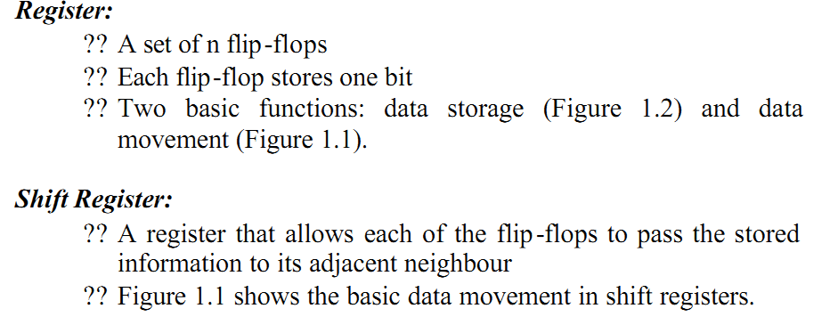

Slide 4
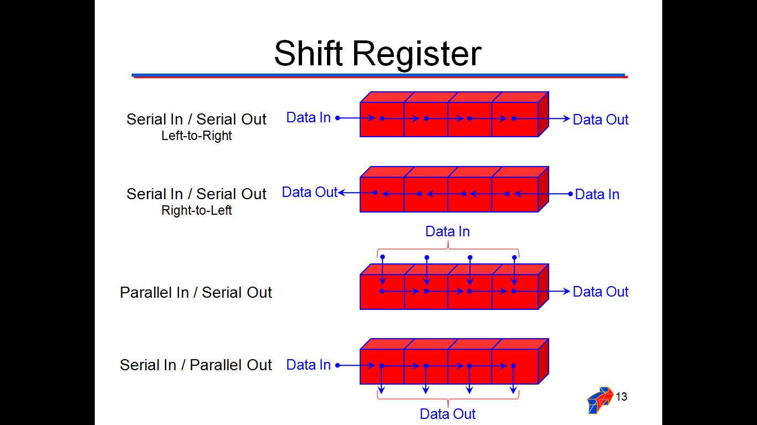

Slide 5
Characteristics of Shift Registers
Number of bits (4-bit, 8-bit, etc.)
Loading
  Serial
  Parallel
Common modes of operation.
  Parallel load
  Shift right-serial load
  Shift left-serial load

Slide 6
Serial/Parallel Data Conversion
Shift registers can be used to convert from serial-to-parallel or the reverse from parallel-to-serial.
Parallel out
Parallel out
Serial out
1 0 1 0 1 1 1 1
1 0 1 0 1 1 1 1
Serial out
Serial in
Serial in
1 0 1 0 1 1 1 1
1 0 1 0 1 1 1 1
Parallel in
Parallel in

Slide 7
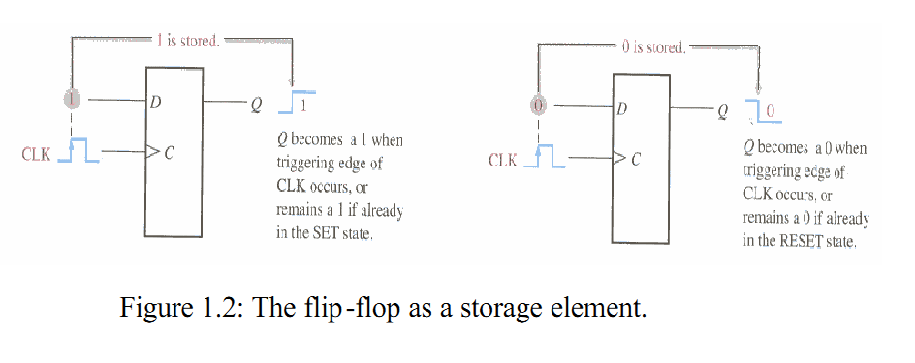

Slide 8
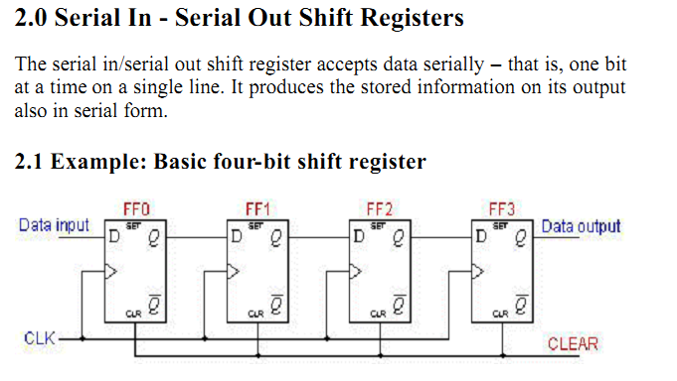

Slide 9
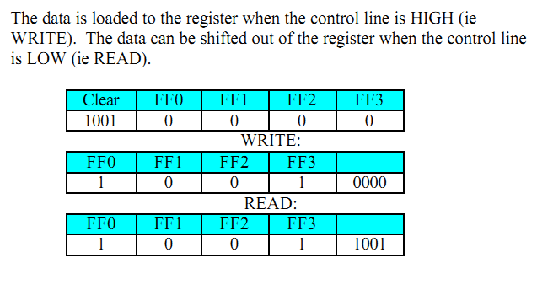

Slide 10
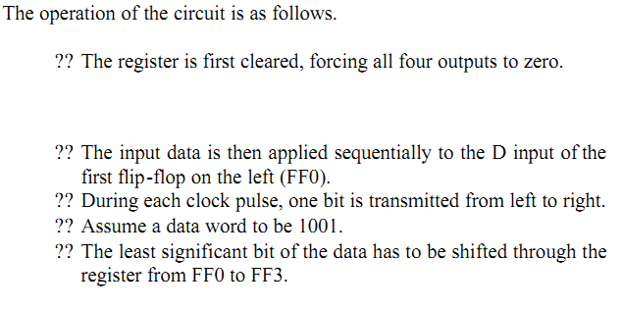

Slide 11
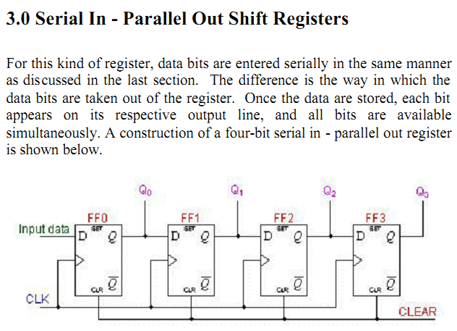

Slide 12
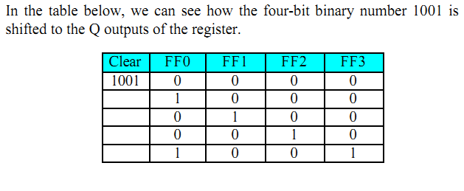

Slide 13
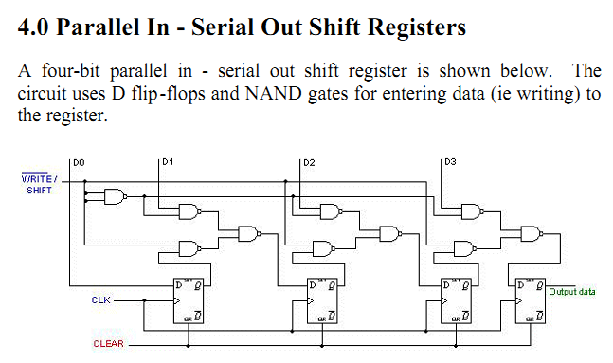

Slide 14
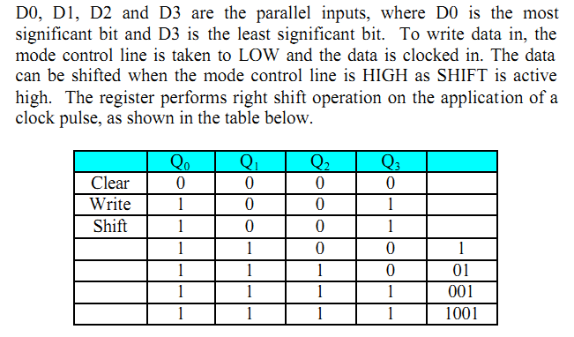

Slide 15
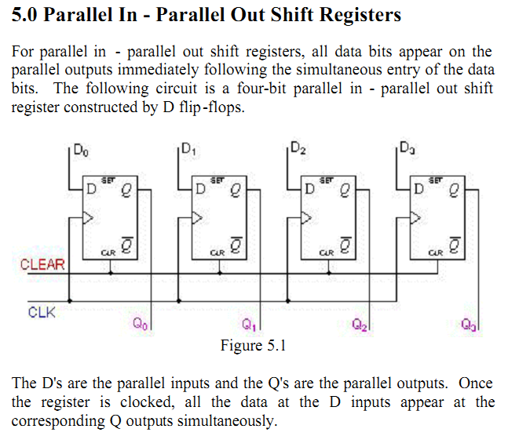
ECE 301 - Digital Electronics

Slide 16

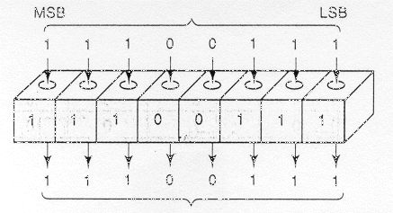
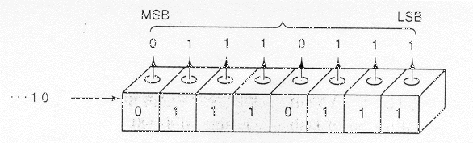
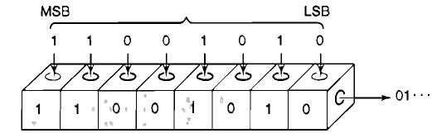
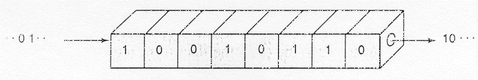
QUIZ
Q#1- This represents a ___ register.
a. Parallel-in, parallel-out
b. Serial-in, parallel-out
Q#2- This represents a ___ register.
a. Parallel-in, parallel-out
b. Serial-in, serial-out
Q#3- This represents a ___ register.
a. Parallel-in, serial out
b. Serial-in, parallel-out
Q#4- This represents a ___ register.
a. Parallel-in, serial out
b. Parallel-in, parallel-out
ANS: serial-in parallel-out
ANS: serial-in serial-out
ANS: parallel-in serial-out
ANS: parallel-in parallel-out

Slide 17
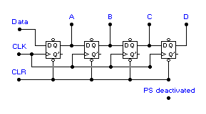
Serial Load Shift Register
Parallel outputs here.
Order= A B C D
0 0 0 0
1 0 0 0
1 1 0 0
0 1 1 0
0 0 1 1
0 0 0 1
1 0 0 0
0 1 0 0
Data = 1
Data = 1
Data = 1
Data = 0
Data = 0
Data = 1
Data = 0
Data = 0
Inputs here:
(1) Data
(2) Clock
(3) Clear
4-bit
serial-in
parallel out
shift right
shift register
Clock input:
Positive-edge
triggering
Clock Pulse 2
Clock Pulse 1
Clock Pulse 3
Clock Pulse 4
Clock Pulse 6
Clock Pulse 7
Clock Pulse 5
Clock Pulse 8
Clear input:
Active = 0
Deactivated = 1
Clear = 1
Clear = 0
Clear = 1
Clear = 1
Clear = 1
Clear = 1
Clear = 1
Clear = 1
Note the use of D FFs.
Clock (CLK) inputs wired in parallel.
Clear (CLR) inputs can be activated with LOW
or disabled with HIGH.
Preset (PS) inputs deactivated.

Slide 18
QUIZ
QUESTION #1
This is a ___ type shift register.
A. Serial-in, parallel out
B. Parallel-in, serial-out
QUESTION #2
What is the 4-bit output (bit A on left, D on right) after pulse 1?
QUESTION #3
What is the 4-bit output (bit A on left, D on right) after pulse 2?
QUESTION #4
What is the 4-bit output (bit A on left, D on right) after pulse 3?
QUESTION #6
What is the 4-bit output (bit A on left, D on right) after pulse 5?
QUESTION #7
What is the 4-bit output (bit A on left, D on right) after pulse 6?
QUESTION #5
What is the 4-bit output (bit A on left, D on right) after pulse 4?
A: Serial-in, parallel-out
A: 0100
A: 1000
A: 1100
A: 0000
A: 0010
A: 1001
Data = 0
Data = 1
Data = 0
Data = 1
Data = 1
Data = 1
Clock Pulse 4
Clock Pulse 2
Clock Pulse 3
Clock Pulse 6
Clock Pulse 5
Clock Pulse 1
Clear = 1
Clear = 1
Clear = 1
Clear = 1
Clear = 1
Clear = 0

Slide 19
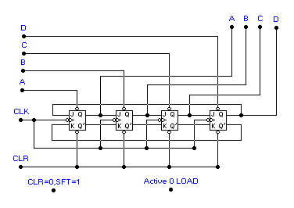
Parallel Load Shift Register
Outputs here.
Order= A B C D
Parallel data
inputs
(Active LOW)
Recirculating
lines:
Pass data from
FFD to FFA
on each
clock pulse.
Clock input- H-to-L
Note the
recirculating
lines.
Clear input- Active LOW
Note the use of J-K FFs.
Clock (CLK) inputs wired in parallel.
Clear (CLR) input activated with LOW.
Parallel load inputs (A,B,C,D) are active LOW.

Slide 20
Recirculating Shift Register
0 0 0 0
0 0 1 1
1 0 0 1
1 1 0 0
0 1 1 0
0 0 1 1
0 0 0 0
0 1 0 0
Parallel data inputs=
only B active
Parallel data inputs=
only D activated
Parallel data inputs=
C & D activated
Parallel data inputs=
all inactive
Parallel data inputs=
all inactive
Parallel data inputs=
all inactive
Parallel data inputs=
all inactive
Parallel data inputs=
all inactive
Clock pulse 8
Clock pulse 1
Clock pulse 2
Clock pulse 3
Clock pulse 5
Clock pulse 6
Clock pulse 7
Clock pulse 4
Clear input= 1
Clear input= 0
Clear input= 1
Clear input= 1
Clear input= 1
Clear input= 1
Clear input= 0
Clear input= 1

Slide 21
QUIZ
Q#1- After clock pulse 1, the output from the shift register
will be ___.
Q#2- After clock pulse 2, the output from the shift register
will be ___.
Q#3- After clock pulse 3, the output from the shift register
will be ___.
Q#4- After clock pulse 4, the output from the shift register
will be ___.
Q#5- After clock pulse 5, the output from the shift register
will be ___.
Q#6- After clock pulse 6, the output from the shift register
will be ___.
0 1 1 0
1 1 0 0
1 0 0 1
0 0 1 1
0 1 1 0
0 0 0 0
Parallel data inputs=
none active
Parallel data inputs=
B and C active
Parallel data inputs=
none active
Parallel data inputs=
none active
Parallel data inputs=
none active
Parallel data inputs=
none active
Clock pulse 1
Clock pulse 2
Clock pulse 3
Clock pulse 4
Clock pulse 5
Clock pulse 6
Clear input= 0
Clear input= 1
Clear input= 1
Clear input= 1
Clear input= 1
Clear input= 1

